Slide 1
QUARTER 3 STATE OF THE HURRICANES

Slide 2
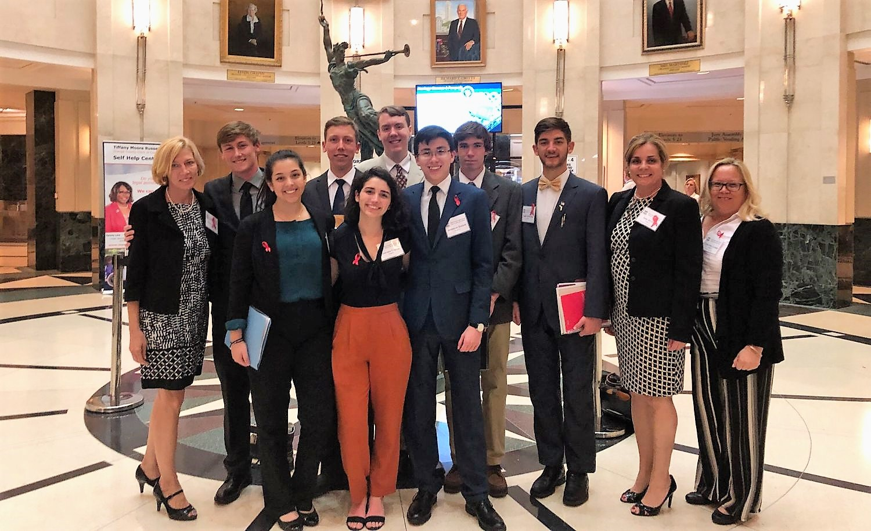
Congratulations Mock Trial Team
Most Professional Award at State Championships
Zane Absten
Joanthan Babich
Kaj Klitgaard
Geo Capitos
Cody Dickerson
Maria Otero
Alex Jordan
Jakob Pooley

Slide 3
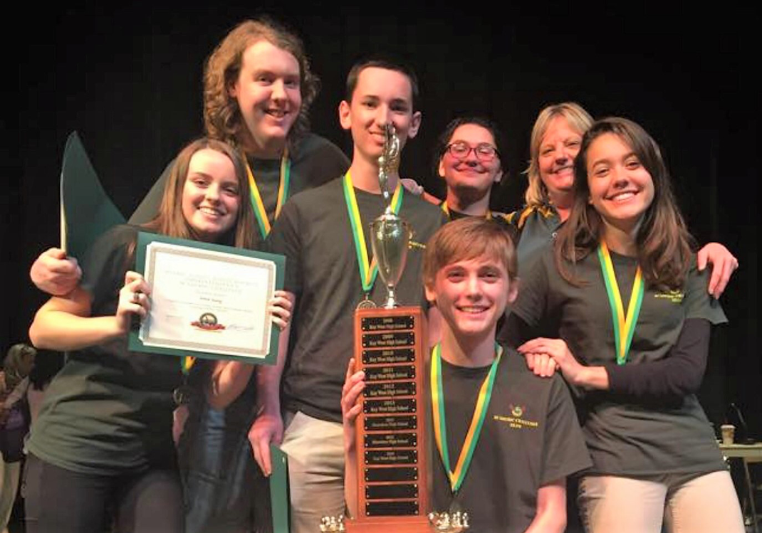
Congratulations Academic Challenge District Champs
Good luck at States this week!
Tyler Arnold
Sofia Garcia
Halley Lane
Jakob Pooley
Tommy Rodberg
Aelish Young
Coach Chris Harris

Slide 4
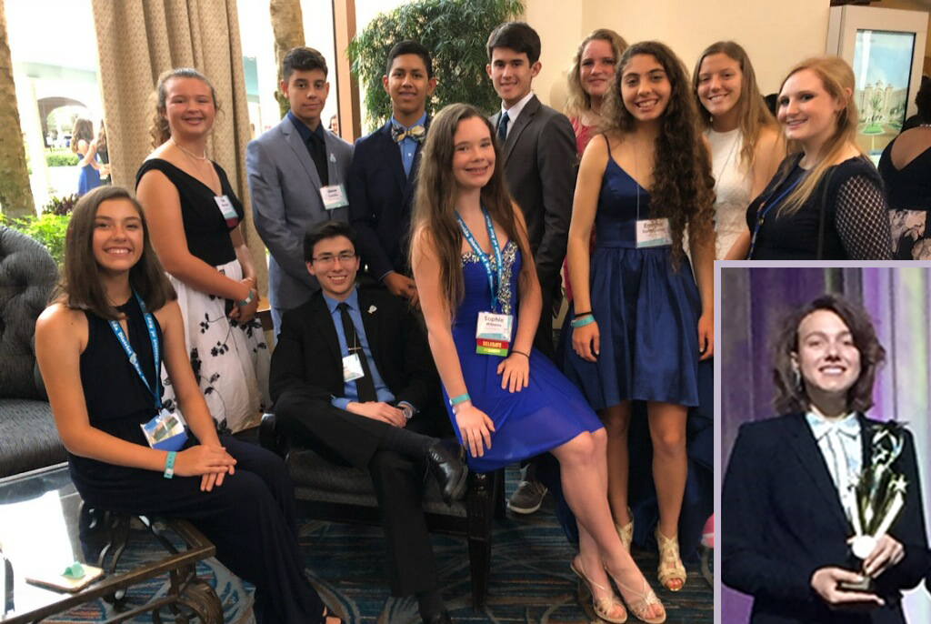
Congratulations Key Club!
1st Place Fundraising Award for UNICEF
Lt. Gov. Lauren Hutchings, Project Eliminate Fundraising Award
Sophie Williams
Jeri Goldberg
Shelby Porter
Jonathan Babich
Riley Dobson
Grace Matthews
Zoe Marchetti
Jason Castillo
Luke Gutierrez
Jorgen Heilbron
Emme Santyana
Anna Langley
Shelby Porter
Lauren Hutchings
Sponsor Ms. Truesdale

Slide 5
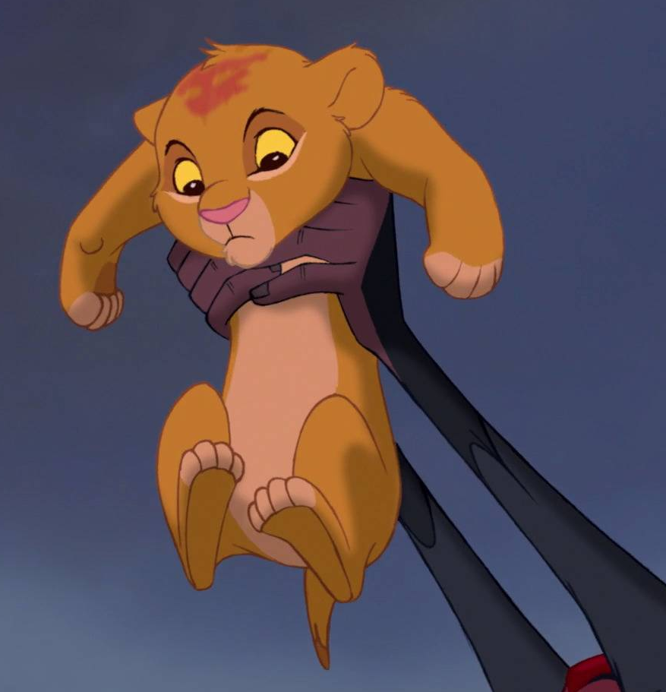
Perfect Attendance Award
Lillian Adrian
Tara Amador
Alexandra Ancheta
Lance Arnold
Angie Axume
Jonathan Babich
Jean Baidet
Valerie Barrow
Elijah Blanco
Anna Carucci
Jason Castillo
Mariano Castillo-Beovides
Dallas Christmas
Timothy Cole
Chayane Cooper
Javier Correa
Jennifer Duque-Diaz
Brandon Dwyer
Cody Farrington
Austin Fernandez
Yoendry Ferro
Joseph Forcine
Allysia Fowler
Thomas Gahagen
Andrea Galvan
Ava Garcia
Antoneya Gaston
Alexander Gonzalez
Karla Gonzalez Gomez
Adam Gordon
Edgar Gutierrez
Eduin Gutierrez
Donovan Hassen
Javier Hernandez
Jackson Hilson
Christian Ignacio
Quinn Johnson
Susan Kendall
Jacob Kirkman
Halley Lane
Roy Lindback II
Cora Long
Michael Maldonado
Zybo Marchetti
Ella Marsden
Sarah McCabe
Daniel Mc Daniel
Mahon Mc Mahon
Adrian Munoz
Arianna Oliver
Angela Ornelas
Jonathan Ornelas
Vanessa Pelaez
Bryan Placencia
Donovan Poe
Kaitlin Pooley
Karli Richards
Erin Rodberg
Thomas Rodberg
Alain Rodriguez-Diaz
Payton Roth
Gabriel Rubiales
Emme Santayana
Jennifer Setchell
Samantha Simon
Sergio Trujillo-Perez
Jessica Vandergriff
Juan Villalobos-Perez
James Warrington Hernandez
Alyssa Webb
Jonathan Williams
Sophie Williams
Roka Wolgamott
Kathleen Young
See Ms. Jaime in attendance

Slide 6
Alain Rodriguez
Albert Rodas
Alex Jordan
Allie Ancheta
Angel Kelley
Brittney Beyer
Brittney Monteagudo
Colton Snodgrass
Craig Beattie
Daniel Pease
Draven Tucker
Foster Coffman
Frank Paterson
George Cuetata
Hadly Dobson
Hunter Frier
Hyatt Spaulding
Jacob Kirkman
Jaculine Oshaben
Jesus Perez
Lauren Hutchings
Matthew Hardison
Maxwell Potter
Mia Harris
Michael Ponse
Michael Valdez
Natalie McCormick
Natalie Rader
Orlando Ortega
Rachael Clark
Robbie Valenzuela
Sandra Delgado
Simon Orjuela
Skyler Hunter
Steelman Nicoletti
Susan Kendall
Taegan Huntemann
Teressa Kent
Tony Thiele
Tristan Woolery
Yaxel Valladares
Zack Rock

Slide 7
Random Acts of Kindness
Anna Carucci
Anna Langley
Anthony Cosme
Anthony Vasilenko
Brandon Norman
Brittany Monteagudo
Cassie Willis
Claudia Avila
Cody Dickerson
Cody Steinmetz
Connor Rhyne
Dane Dallas
Draven Tucker
Ethan Osborne
Hyatt Spaulding
Irina Gonzalez
Jacqueline Oshaben
Jen Avelar
Jorgen Heilbron
Josh Goodwyn
Juan Fleites
Julianne Jankowski
Kegan Morris
Krysten Starr
Kyla Caterineau
Leesa Ross
Luke Gutierrez
Mabel Martinez-Benitez
Mackenzie Emrich
Malissa Mauthe
Matthew Sisko
Miguel Quezada
Noah Leach
Olivia Betancourt
Rachel Medina
Ralph Howell
Robbie Prosek
Rosa Rodas
Ryan De La Torre
Samantha Howell
Samantha Wright
Shelby Porter
Skylynn Lindback
Teressa Kent
Tye Harreslon
Vaclav Cernosek
Yahely Onelas
Yaire Mollineda

Slide 8
Ms. Andersen
Math Rockstars
Period 1
Miguel Gonzalez Gomez
Socrates Zapsas
Period 4
Isabella Contreras
Most Improved:
Tony Thiele
Period 7
Abby Sebben
James Warrington
Period 3
Thomas Gahagen
Daisy Esparza
Period 5
Justin Pawlikowski
Triton Mitten

Slide 9
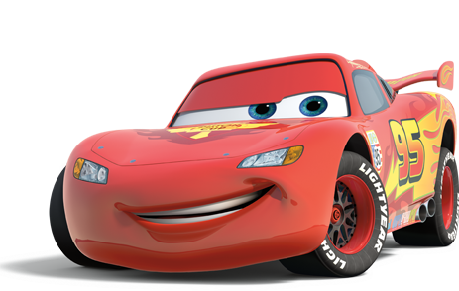
Automotive Level 1:
Daniel Pease
Luke Gutierrez
Hailey Cobb
Yoendry Ferro
Joseph Forcine
Javier Hernandez
Automotive Advance 2 & 4:
Edgar Gutierrez
Nick Norman
Robert Rivera
Brandon Rowland
Automotive Advance 3:
Orlando Ortega
Cody Steinmetz
Michael Ponce

Slide 10
Digital Info Tech
Tyler Arnold, Katy Borders, Maggie Duckworth
Custom Promotional Layout & Design
Julie Cano, Patryck Pietruch, Cassie Willis
Promo Design & Management:
Lillie Carter, Barbara Mendez, Sophie Williams
AP Computer Science Principles
Period 4 Tyler Arnold, Lauren Hack, Jorgen Heilbron
Period 5 Matthew Darrow, Hunter Frier, Miguel Quesada
Period 6 Shennan Kasprzak, Tim Orr, Jacob Webb

Slide 11
Students of the Quarter:
Josue Lara
Alex Castillo
Leesa Ross
Nick Norman
Tomisha Caldwell
Michael Valdes
Maggie Duckworth
Mia Harris
Steelman Nicoletti
Tony Thiele

Slide 12
Mr. Catlett
Marine Outboard 1:
Michael Valdez & Daniel Pease
Marine Outboard 2:
Skyler Hunter & Colton Snodgrass
Marine Outboard 3:
Orlando Ortega & Craig Beattie
Marine Outboard 4:
Foster Coffman & Hyatt Spalding

Slide 13
Period 2 – U.S. History:
Skye Alwardt
Brayan Rojas Ramon
Period 5 – U.S. History:
Rachel Clark
Alejandro Chairez-Ramos
Period 6 – U.S. History:
Jaime Aucamp
Jennifer Avelar
Mackenzie Emrich
Period 3 – AP Psych:
Hannah Lane
Marlie Cakans
Period 4 – AP Psych:
Luke Gutierrez
Madeline Chilton
Most Improved:
Cody Arnette
Michael Ponce
Pedro Diaz Lopez

Slide 14
Period 1 Antoneya Gaston, Amber Salyer
Period 2 Javier Hernandez, Nick Rodriguez
Period 3 Katie Holly, Blakely Harden, Brianna Johnson
Period 4 Nicole Dotschay, Josue Lara
Period 5 Cheyanne Cooper, Cheyenne Veloso
Period 7 Amy Garcia, Jennifer Setchell, Orlinda Lorente

Slide 15
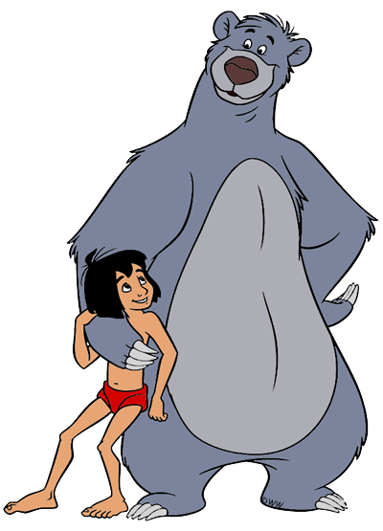
Outstanding Effort
Will Mutz
Most Improved
Sophia Gonzalez

Slide 16
Biology
Period 1: Susan Gutierrez,
Vaclav Cernosek
Period 2: Kegan Morris
Period 3: Olivia Betancourt
Period 6: Irina Gonzalez
Marine Science
Period 4 Honors: AJ Leffler
Period 5: Melannie Rodas-Guevara

Slide 17
Ms. MJ Fry
U.S. Government:
Jay Kubida, Connor Rhyne, Katherine Ware, Jacob Webb
U.S. History:
Jeri Goldberg, Thomas Rodberg,
Tristan Woolery, Christian Ignacio,
Morgan Whittle

Slide 18
Ms. Robin Fry
English II Honors:
Amy Garcia
Jennifer Setchell
English IV:
Paul Ross
Edgar Gutierrez
AP Language:
Katie Robinson
Yahely Ornelas

Slide 19
Ms. Gagliardini
Students of the Quarter:
Mariah Bell
Chris Hernandez

Slide 20
Mr. Gideon
Earth & Space Science:
Quinn Johnson, Marc Petrusha,
Cayleigh Deakins, Migual Gonzalez
AP Physics:
Jay Kubida
Physics 1:
Tatiana Ayala-Gonzalez

Slide 21
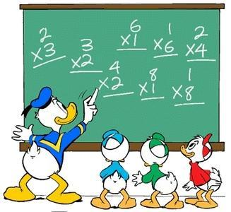
Ms. Deborah Hamilton
AP Statistics:
Angela Ornelas & Skylnn Lindback
Honors Geometry:
Amy Garcia, Alyssa Webb, Sara Duffy, & Julie Powers
Geometry:
Olivia Betancourt

Slide 22
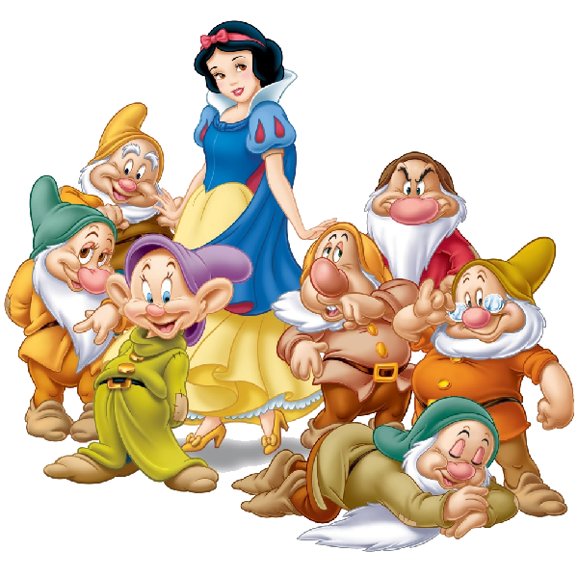
Ms. Hamilton (P.E.)
Students of the Quarter:
Rebecca Galvan
Edgar Gutierrez

Slide 23
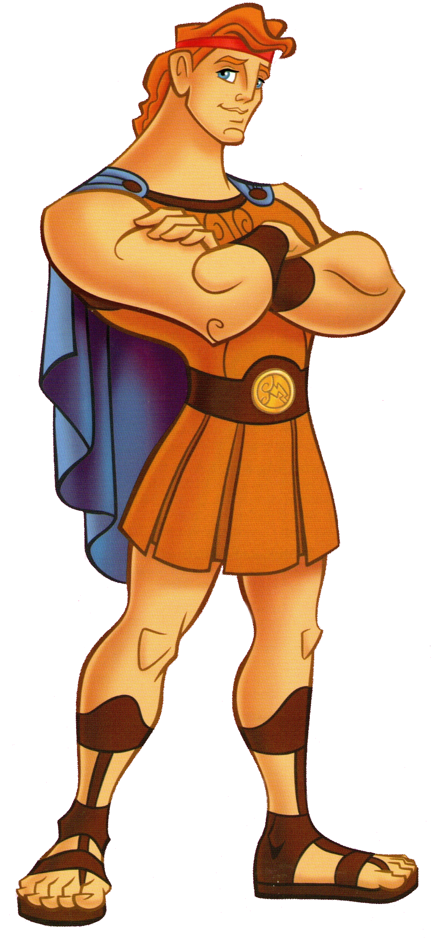
Mr. Hane
Outstanding Students:
3rd Period – Reading: Teressa Kent, Jordan Whitehead
4th Period – Reading: Alejandro Camacho, Misty Owens
5th Period – Integrated Science: Sky Alwardt, Ryan Guth
6th Period – Integrated Science: Cody Arnette,
Kevin Guerrero, Leesa Ross
7th Period – World History: Lina Coole, Amber Wigle

Slide 24
Mr. Hughes
Period 1: Zachary Canton, Sergio Trujillo-Perez
Period 2: Karla Gonzalez-Gomez, Yaire Mollineda
Period 4: Susan Gutierrez, Evelyse Hernandez-Infante
Period 6: Skylar Poisson-Zettwoch, Keely Flanagan
Period 7: Angel Martin Santos, Zechariah Rock

Slide 25
Ms. Joy
Students of the Quarter:
Albert Rodas
Rosa Rodas-Gallardo
Lorenzo Scott
Jonah Schafstall
Luis Olivia
Kanvis Frails
Javier Diaz
Julien Baidet

Slide 26
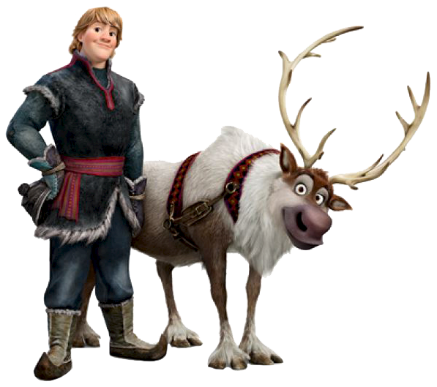
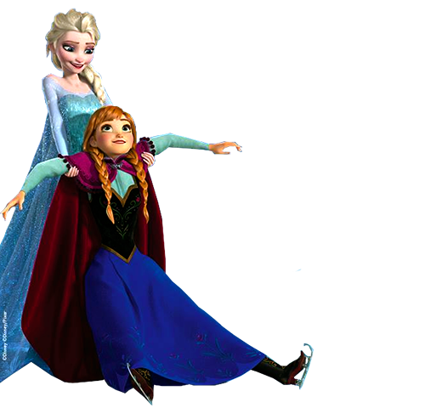
Economic Enthusiasts:
Anna Wilson, AJ Leffler,
Brittney Beyer, Zach Schrader-Grace
Great Geographers:
Brent Johnson, Daniel Pease, Andrea Galvin,
James Warrington Hernandez, Ashley Hilson,
Thomas Gahagen

Slide 27
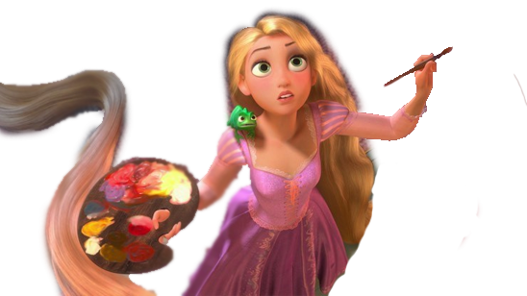
Ms. Kelley
Drawing 1
Braden Mathews
Sofie Kubida

Slide 28
Mr. Kirkley
Honors English 1:
Vanessa Perez
Julie Powers
AP English Literature and Composition:
Julia Prieto
Kendra Powers

Slide 29
Ms. Knudsen
Students of the Quarter:
Jason Castillo
Maggie Duckworth

Slide 30
Ms. Ledoux
APES: Stephen Franks
Lily Costa
Biology Honors:
Matthew Darrow
Ali Woltanski

Slide 31
Ms. Lozano
Interns of the Quarter:
Albert Rodas
Jesus Perez
Alexis Rainwater

Slide 32
Students of the Quarter:
2nd Hour Imani Murphy
3rd Hour Alyssa Webb
4th Hour Haley Pacyna
6th Hour Taylore Kent
7th Hour Sarah McCabe

Slide 33
Ms. O ‘Connor
English II Student of the Quarter:
Carlos Magdaong
Kevin Robles
Susan Kendall
Susan Gutierrez
English II Honors Student of the Quarter:
Matthew Darrow
Lauren Hack
Jonathan Williams
Daniel Ornelas

Slide 34
Ms. Oshaben
Period 1
Leo Snell
Sarah McCabe
Period 2
Callie Bloom
Quinn Johnson
Period 3
Katelyn Gremonprez
Jonah Schaffstall
Period 4
Elijah Blanco
Grace Matthews
Period 5
Nathan Pontrefact
Andrea Galvan

Slide 35
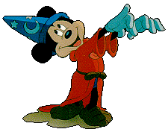
Mr. Poelma
1st Period Biology Honors:
Jackie Wiktorek, Emme Santayana
2nd Period Earth Space Science Honors:
Kaylee Jensen, Linsey Pardo
4th Period Earth Space Science Honors:
Donovan Hassen, Krista Black
5th AP Biology:
Jul Jankowski, Jonathan Babich
6th Biology Honors:
Nathan Pontefract, Neve Addie

Slide 36
Ms. Rehmann
Honors Chemistry:
Raffie Baker
Daniel Ornelas
Colton Snodgrass
Brian Miller
Chemistry I:
Amanda Amador
Mabel Martinez
AP Chemistry:
Halley Lane
Hunter Frier

Slide 37
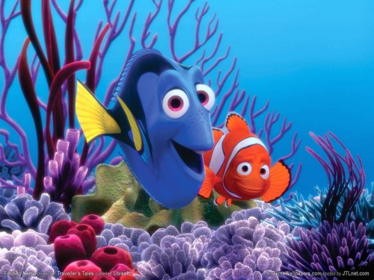
Ms. Rosenow
Marine 1 Honors:
Jeri Goldberg
Kyle Kraus
Marine 2 Honors: Alexis Romero
Ariana Lindback
Leadership:
Brittany Beyer
Kelsea Steinmetz

Slide 38
Ms. Ruiz
Excellence in Spanish 1:
Jena Jones

Slide 39
Mr. Russell
Commercial Fishing 1:
Tony Bates
Jason Kaska
Nick Norman
Michael Stevens
Commercial Fishing 2-4:
Calab Endricks
Mason Baker
George Guerra

Slide 40
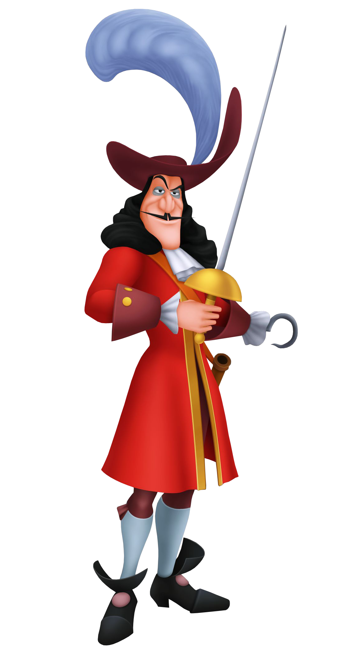
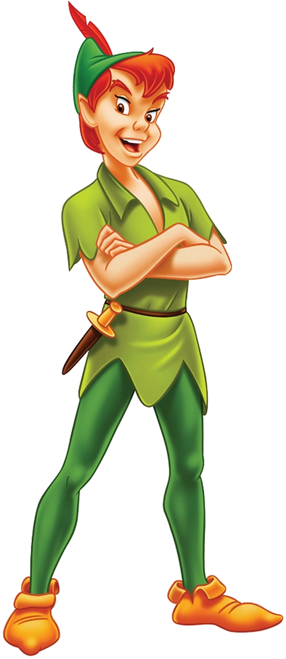
Mr. Suarez
4th Period Caitlyn Able Nichole Thomas Aelish Young 5th Period Tatiana Ayala Hailey Cobb Roy John Lindback II 6th Period Cameron Barton Brianna Costa Edgar Gutierrez
Honorary Student of the Quarter Victoria Lindsey Most Improved Devin Wolf
1st Period Alex Castillo Seamus Doughtery Airiana Lindback 2nd Period Landon Gardner Gina Hernandez Anthony Leffler 3rd Period Alex Jordan

Slide 41
Ms. Susa
MOST OUTSTANDING STUDENT
Josh Goodwyn
100% in Ms. Susa’s English Classes:
Miguel Quezada
Angel Kelley
Mathew Hardison
Valente Reynoso-Heaton
Hailey Pacyna
Leila Isador
Tim Orr
Alain Rodriguez-Diaz
Michael Signorelli

Slide 42
Ms. Thiery
Digital Productions Digital 1: Lauren Fundyk Emma Kost Julie Powers Ava Garcia Andrea Galvan Krista Black Kailee McDaniel
Digital 2: Raffie Baker Jessica Koval Isabella Bolivar Nola Frank Jonathan Williams Natalie McCormick
Advanced: Katie Young Macey Harrelson Kendra Powers
Student of the Year:
AJ Leffler

Slide 43
Ms. Truesdale
AP Macroeconomics:
Jorgen Heilbron
Kendra Powers
Julia Prieto
English IV:
Sergio Trujillo-Perez
Gina Hernandez
Leesa Ross
Devin Wolf

Slide 44
AP Human Geography:
Period 2: Nathan Pontefract
Kaylee Stoky
Period 3: Allie Adler
Sarah Duffy
Period 6: Donovan Hassen
Jackie Wiktorek
Anthropology:
Period 4: Rebecca Galvan
Period 5: Rachel Machado
Period 7: Kaj Klitgaard

Slide 45
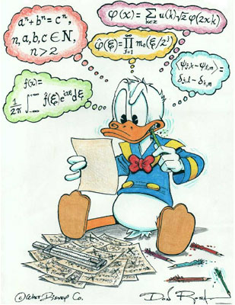
Ms. Wischmeier
Most Improved:
Mikey Panse
Jessie Head
Windley Hagood
Mathew Hardison
Alejandro Tovar-Morales
Ben Zelada
Kaitlin Pooley

Slide 46
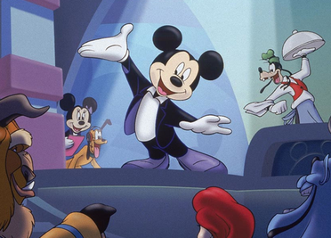
Ms. Zofchak
1st Period:
Lorena Carballo
Kaylee Jensen
Maximus Stough
2nd Period:
Zach Armstrong
Will Cunningham
Sammie Simon
3rd Period
Miguel Quesada
Elise Jordan
Cheyenne Veloso
5th Period
Ella Adams
Katelyln Gremon-Prez
Gabby Hernandez
Theater 1:
Brent Johnson
Theater 2:
AJ Leffler
Theater 3 Honors:
Savannah Liberty

Slide 47
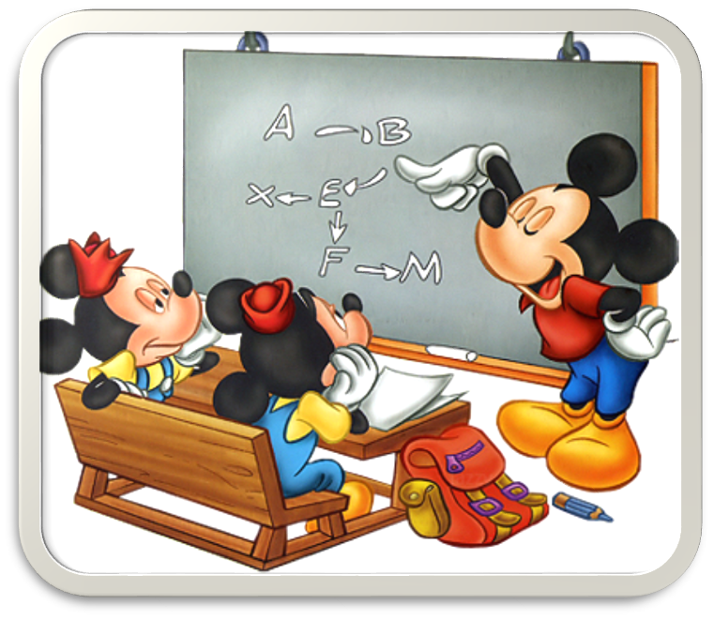
HONOR ROLL
Caitlyn Abel
Autumn Addie
Taylor Albury
Sandra Amador
Alexandra Ancheta
Gianna Ancheta
Brayan Argueta
Noah Arnold
Tyler Arnold
Jaime Aucamp
Victoria Aucamp
Jennifer Avelar
Angie Axume
Julien Baidet
Cameron Barton Blanco
Craig Beattie
Olivia Betancourt
Brittany Beyer
Elizabeth Black
Krista Black
Isabella Bolivar
Katharina Borders
August Borski
Josef Borski
William Butler
Bryce Bynum
Avery L Caceres
Martha Iris Calix
Colin Campbell
Lorena Carballo
Lillie Carter
Caitlyn Casariego
Liana Castagna
Alexander Castillo
Vaclav Cernosek
Alejandro Chairez-Ramos
Madeline I Chilton
Dallas Christmas
Rachael Clark
William Coffin
Clayton Conley
Courtney Conley
Isabella Contreras
Chayane Lee Cooper
William Cunningham
Jacob Curry
Dane Dallas
Ria Del Pino
Gage Dennis
Lucas G Dennis
Javier Diaz
Cody Dickerson
Dominic DiMaggio
Seamus Dougherty
Clark Drebenstedt
Kevin Gutierrez
Sarah - Duffy
Cameron El-Koury
Yoendry Ferro
Jason Filpes
Lily Firkins
Keely Flanagan
Andrew Fleites
Kathleen Foley
Joseph Forcine
Allysia Fowler
Kanvis Frails
Nola Frank
Stephen Franks
Christian Frisone
Lauren Fundyk
Andrea Galvan
Rebecca Galvan
Ava Garcia
Javier Garcia
Sofia Garcia
Antoneya Gaston
Daniel Gideon
Miguel Gomez
Alexander Gonzalez
Irina Gonzalez
Sofia Gonzalez
Miguel Gonzalez Gomez
Katelyn Gremonprez
Ryan Guth
Edgar Gutierrez
Eduin Gutierrez
Luke Gutierrez
Haley Guy
Blakely Harden
Brandon Harrison
Donovan Hassen
Aiden Hawkins
Jessie Head
Christopher Hernandez
Gina Hernandez
Javier Hernandez
Ashley Hilson
Katie Holly
Victoria Hoover
Ralph Howell
Dylan Hussey
Lauren Hutchings
Dallas Hutchinson
Christian Ignacio
Isabel Jacobsen
Julianne Jankowski
Sierra Jenkins
Jena Jones
Alex Jordan
Paige Joyce
Cody Kennedy
Michela Kidd
April Klein
Kaj Klitgaard
Jessica Koval
Jay Kubida
Sophie Kubida
Hannah Rene Lane
Brian Leffler
Airiana Lindback
Carly Lindback
Skylynn Lindback
Richard Lindsay
Jack Lindsey
Max Lindsey
Orlinda Lorente
Rachel Machado
Carlos Magdaong
Rachelle Magdaong
Luis Maldonado
Michael Maldonado
Zybo Marchetti
Emma Marsden
Angel Martin
Katelyn McCollum
Kailee McDaniel
Rachel Medina
Brian Miller
Brittney Monteagudo
Tyler Munchmeyer
Thomas Nelson
Steelman Nicoletti
Isabella Olsen
Connor O'Neill
Juan Orjuela
Adriana Ornelas
Angela Ornelas
Daniel Ornelas
Yahely Ornelas
Jacqueline Oshaben
Hailey Pacyna
Lisney Pardo-Figueroa
Jared Pastuck
Brooke Peacock
Lorena Perez
Frank Perlik
Donovan Poe
Skylar Poisson-Zettwoch
Michael Ponce
Shelby Porter
Joshua Prince
Miguel Quezada
Noel Quezada
Noemi Quezada
Alexis Rainwater
Damaris Rego
Jesse Rego
Connor Rhyne
Katherine Robinson
Lucia Rodriguez
Samantha Rodriguez
Zachary Rodriguez
Alondra Rodriguez-Diaz
Claudia Hernandez Rodriguez
Ramon Brayan Rojas
Leesa Ross
Sara Roth
Brandon Rowland
Sara Rubalcava-Mendoza
Gabriel Rubiales
Emme Santayana
Jonah Schafstall
Lorenzo Scott
Abigail Sebben
Kailey Seiler
Jennifer Setchell
Genevieve Sheehy
Cody Steinmetz
Alexander Sternberg
Emily Stickney
Maximus Stough
Tony Thiele
Hannah Thomas
Nichole Thomas
Alejandro Tovar-Morales
Draven Tucker
Jessica Vandergriff
Krystopher Velunza
Landon Walker
Hernandez James Warrington
Jacob Webb
Jacquelyn Wiktorek
Jonathan Williams
Cassandra Willis
Berkley Wolgamott
Chris Wong
Anna Makenzie Wright
Kathleen Young

Slide 48
STRAIGHT A HONOR ROLL
Lillian Adrian
Tara Amador
Jonathan Babich
Raffie Baker
Elijah Blanco
Callie Bloom
Marlie Cakans
Perry Carlson
Anna Carucci
Jason Castillo
Kyla Catarineau
Lily Costa
Matthew Darrow
Hunter Dixon
Maggie Duckworth
Austin Fernandez
Molly Gahagen
Amy Garcia
Niomi Garcia
Jeri Goldberg
Sheila Gonzalez
George Guerra
Susan Gutierrez
Lauren Hack
Windley Hagood
Jorgen Heilbron
Taegan Huntemann
Quinn Johnson
Susan Kendall
Emma Kost
Halley Lane
Anna Langley
Victoria Lindsay
Cora Long
Zoe Marchetti
Ella Marsden
Alexis Martin
Mabel Martinez-Benitez
Keiry Martinez-Garcia
Grace Matthews
Angelina Nappi
Bethany Norling
Simon Orjuela
Timothy Orr
Ethan Osborne
Crissty Owens Henrriquez
Vanessa Pelaez
Michael Petrusha
Patryk Pietruch
Nathaniel Pontefract
Julie Powers
Kendra Powers
Julia Prieto
Bridget Rader
Rose Rodas-Gallardo
Erin Rodberg
Thomas Rodberg
Alain Rodriguez-Diaz
Alexis Romero
Maglyn Scott
Leo Snell
Colton Snodgrass
Kaylee Stoky
Sergio Trujillo-Perez
Zane Turbessi
Alyssa Webb
Zachary Webb
Amber Wigle
Sophie Williams
Anna Wilson
Alison Woltanski
Aelish Young
Abigail Zischka

Slide 49
Congratulations!

Slide 50
Credits
Sophie Williams
Lillie Carter
Assistance
Matthew Darrow
Shennan Kasprzak
Maranda Piekarski

